Slide 1

Super shining company
Cleaning services redefined

Slide 2
introduction
Welcome to super shining pitch deck presentation
Our mission: super shining company offers professional office cleaning, carpet cleaning, sofa set cleaning and even general cleaning services that the client would want. out team ensures that the premises is clean at all time
Our vision: to capture a bigger market share to increase our profit margin.

Slide 3
The problem
Time Constraints: Many individuals lead busy lives with demanding schedules, leaving them with little time or energy to devote to cleaning their homes or workplaces effectively.
Hygiene and Health: Maintaining a clean environment is essential for promoting good health and hygiene. Dirty or unclean spaces can harbor germs, bacteria, and allergens, leading to health issues such as respiratory problems, allergies, and infections.
Environmental Impact: Many individuals and businesses are increasingly concerned about the environmental impact of cleaning products and practices. Professional cleaning services can offer eco-friendly cleaning solutions that minimize harm to the environment while still delivering effective results.

Slide 4
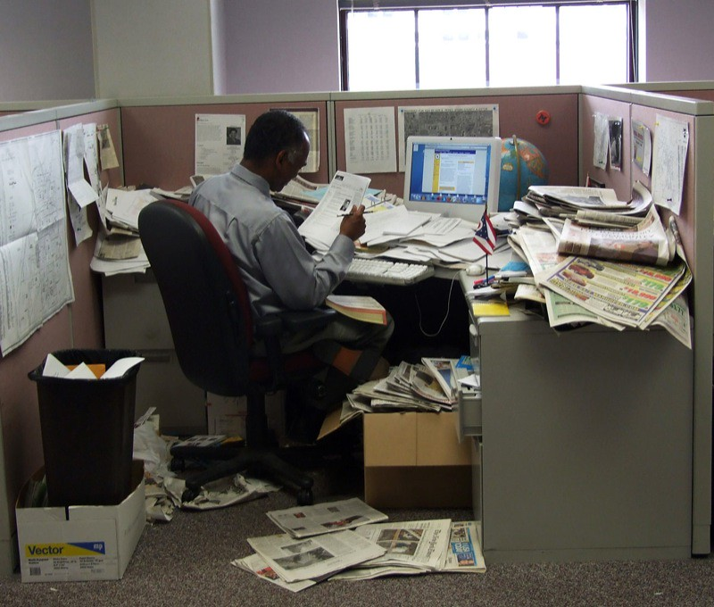

Comparison of clean and unclean environment.
Dirty work place clean work place

Slide 5
Our solutions
We are determined to offer better solutions in cleaning services both in commercial and workplace cleaning services
The solutions will be achieved by offering services professionally by our trained cleaners

Slide 6
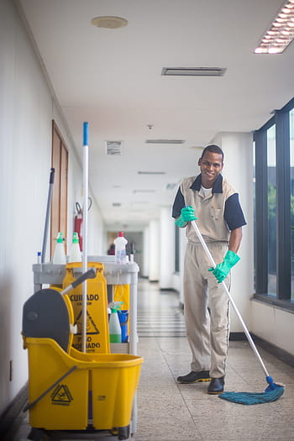
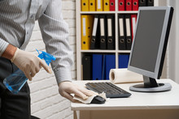
Images showcasing our solutions
Common area cleaning office cleaning

Slide 7
Market opportunity
Across the country cleaning business has been an explosion growth over the last 7 years. Our market research has shown that many clients prefer cleaning companies than private cleaning individuals for security reasons.
Our market share

Slide 8
Our services.
Our clients are commercial building owners, international schools and business premises owners.
The services we offer includes
Commercial cleaning
Residential cleaning
Deep cleaning
Land scapping and many others

Slide 9
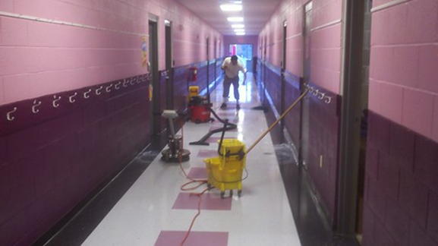

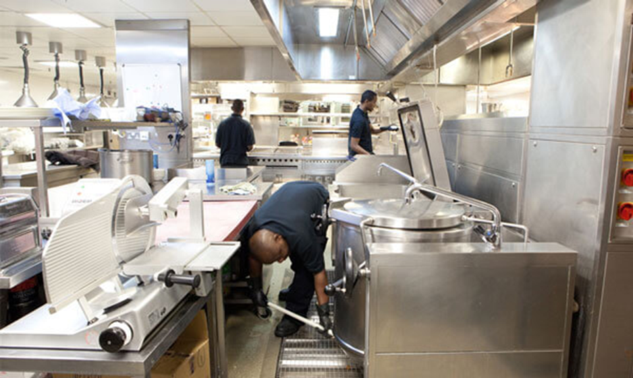

Images showcasing our services commercial cleaning residential cleaning deep cleaning land scapping

Slide 10
Competitive advantages
In the business world healthy competition is normal and this will not be ignored by super shining company.
Within the areas of operations we are very keen to know the strength and weaknesses of our competitors.
Super shining company is aiming at being at the top rank by meeting clients expectations through quality service by qualified staffs.

Slide 11
Our team
The business will adopt two levels of management. Management team comprises of the owner/ managing director and the supervisors.
The other level other personnel's of accountants, sales and marketing team, drivers and employees.
Benson James-managing director
Judith mwangi-sales and marketing
Steven ouma-expertise advisor

Slide 12
Client testimonial
Providing cleaning services is a crucial thing that we are determined to offer professionally at any given opportunity.
For the period we have been in the business, the client testimonials has made us gain in terms of the market share increasing our profit margin
The quality of our services and even the professionalism displayed by of our staff is commendable from all the site we have a contract
Because of this super shining is gradually turning out to be the cleaning company of your choice

Slide 13
Growth strategy
1.Super shining company intends to occasionally do promotions and advertising our services by our staffs who have undergone through training on how to use products and other machines cleaning.
2.The business will ensure our clients get better services. With all mentioned we are determined to capture a bigger market share

Slide 14
Financial projection.

Slide 15
Why partner with super shining company
The super shining company’s market strategy is to standardize the quality of cleaning services just as our slogan states “ all time shining”.
In our market strategy we will be emphasizing on the quality personalized services we provide.
The strategy , mission and vision of the business is what makes us unique and also attract clients and investors. Above are the response to the question of why partner with super shining company.

Slide 16
Contact information
Any partner, any client who would want to do business with super shining can reach us through a contact or email provided below
0714257681
supershining@gmail.com

Slide 17

Conclusion
The super shining company would like to appreciate and thank you for listening to our business presentation. We are looking forward to welcome new partners and even to work with new clients

